Slide 1
UPROOTED
REVISITED:
--------------------
Building a Predictive Model
Brian Salant
Dylan Howe
Kaori Niina

Slide 2
TABLE OF CONTENTS:
------------------------------------------
Analysis Question
Building a Custom Dataset
Multivariate Linear Regression
Testing & Training Process
Predictive Modeling Results
Coding Highlights
Challenges

Slide 3

1.ANALYSIS QUESTION:
------------------------------------------
How will the percentage of a country’s population with
refugee status change
over time?
---------------

Slide 4
2. BUILDING A CUSTOM DATASET: Data Sources
------------------------------------------
HDI Index (UNDP): A statistic composite index of life expectancy, education, and per capita income indicators.
UCDP Battle-related Deaths Dataset (Uppsala Conflict Data Program): Dataset with information on the number of battle-related deaths in conflicts from 1989-2017 that appear in the UCDP/PRIO Armed Conflict Dataset.
Population without access to improved water source (World Bank): The absolute number of people with and without access to an improved water source as calculated by OurWorldinData based on the share of a country’s population with access and the total population. Both of these datasets sourced from the World Bank, World Development Indicators.
Human Rights Protection Scores (Christopher Farris and Keith Schnakenberg): The human rights protection scores estimate the respect for human rights. Higher scores indicate more respect for human rights (and vice versa).
Persons of Concern (UNHCR) - The database contains data about UNHCR's populations of concern, including refugees, from the year 1951 up to 2017.
Population (World Bank)
Annual GDP Growth (World Bank)
Access to Electricity – Percentage of population (World Bank)

Slide 5
2. BUILDING A CUSTOM DATASET: Raw Data
------------------------------------------

Slide 6
3. MULTIVARIATE LINEAR REGRESSION:
------------------------------------------
------------------------------------------
Chosen because of it’s suitability for time-series analysis.
Tested, trained and fitted the model with a total of 8 features.
Our dataset started out quite large (with over 8K rows); however, after cleaning the data to fit the model, we kept approximately 3K rows depending on the imputation method (Ffill / Means).

Slide 7
4. TESTING & TRAINING PROCESS:
------------------------------------------
t | Means/Ffill | Final Year | Number of Rows | R2
15 | means | 2002 | 1764 | 0.83363429
8 | means | 2009 | 2984 | 0.74447454
8 | ffill | 2009 | 2950 | 0.73341976
6 | ffill | 2011 | 3305 | 0.59751641
6 | ffill | 2009 | 2951 | 0.51397853
6 | means | 2009 | 2985 | 0.71918114
6 | means | 2011 | 3337 | 0.60327483
4 | means | 2009 | 2987 | 0.36344614
4 | means | 2013 | 3690 | 0.33584285
4 | ffill | 2009 | 2953 | 0.26690444
4 | ffill | 2013 | 3656 | 0.32113996
2 | means | 2009 | 2989 | 0.09028854
2 | means | 2014 | 3868 | 0.0907012
2 | ffill | 2009 | 2955 | -0.2054202
2 | ffill | 2014 | 3834 | 0.08117838

Slide 8
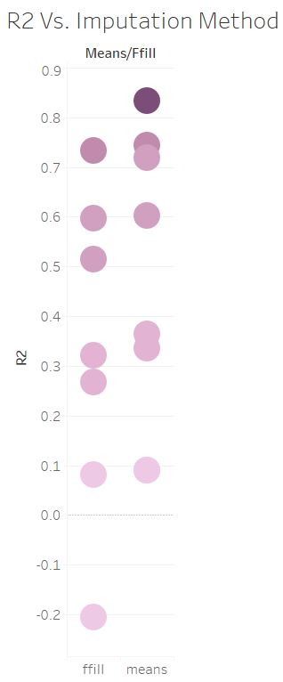
5. PREDICTIVE MODEL ACCURACY: Visualized
------------------------------------------
Imputing data when there were 5 or less missing values using means, consistently gave higher results than filling missing data points using Ffill.
Ffill is a forward fill that takes prior year data, and uses it to fill the missing value

Slide 9
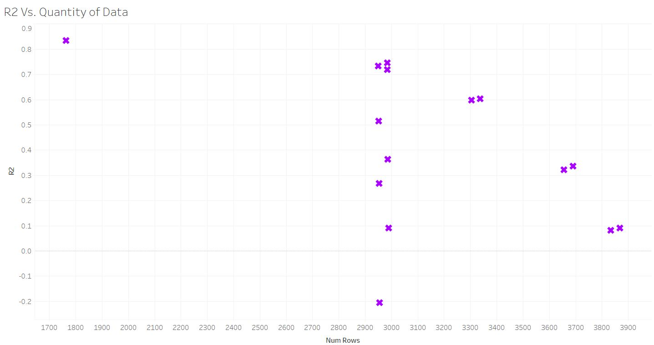
5. PREDICTIVE MODEL ACCURACY: Visualized
------------------------------------------

Slide 10
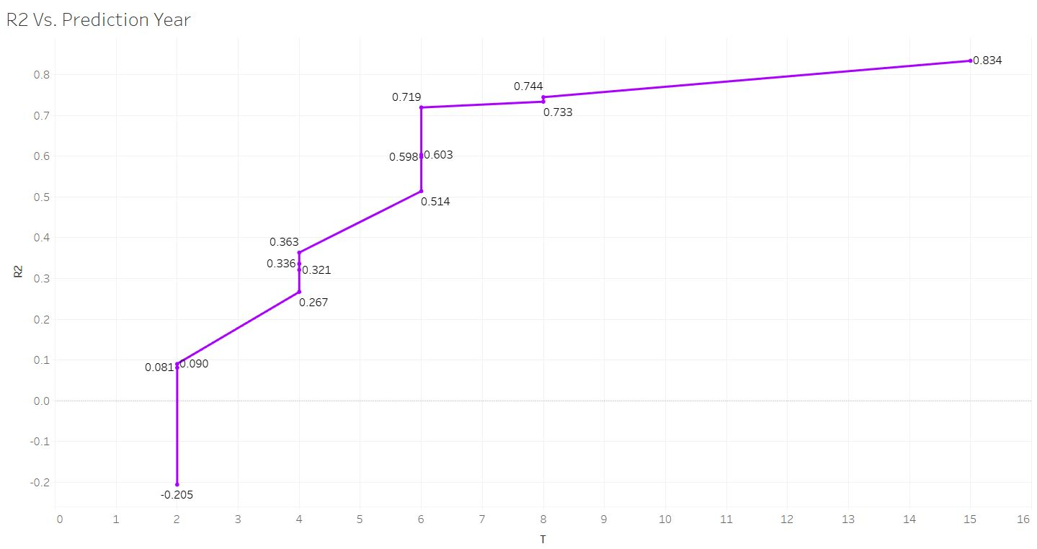
5. PREDICTIVE MODEL ACCURACY: Visualized
------------------------------------------

Slide 11
5. PREDICTIVE MODEL RESULTS: Visualized
------------------------------------------

Slide 12
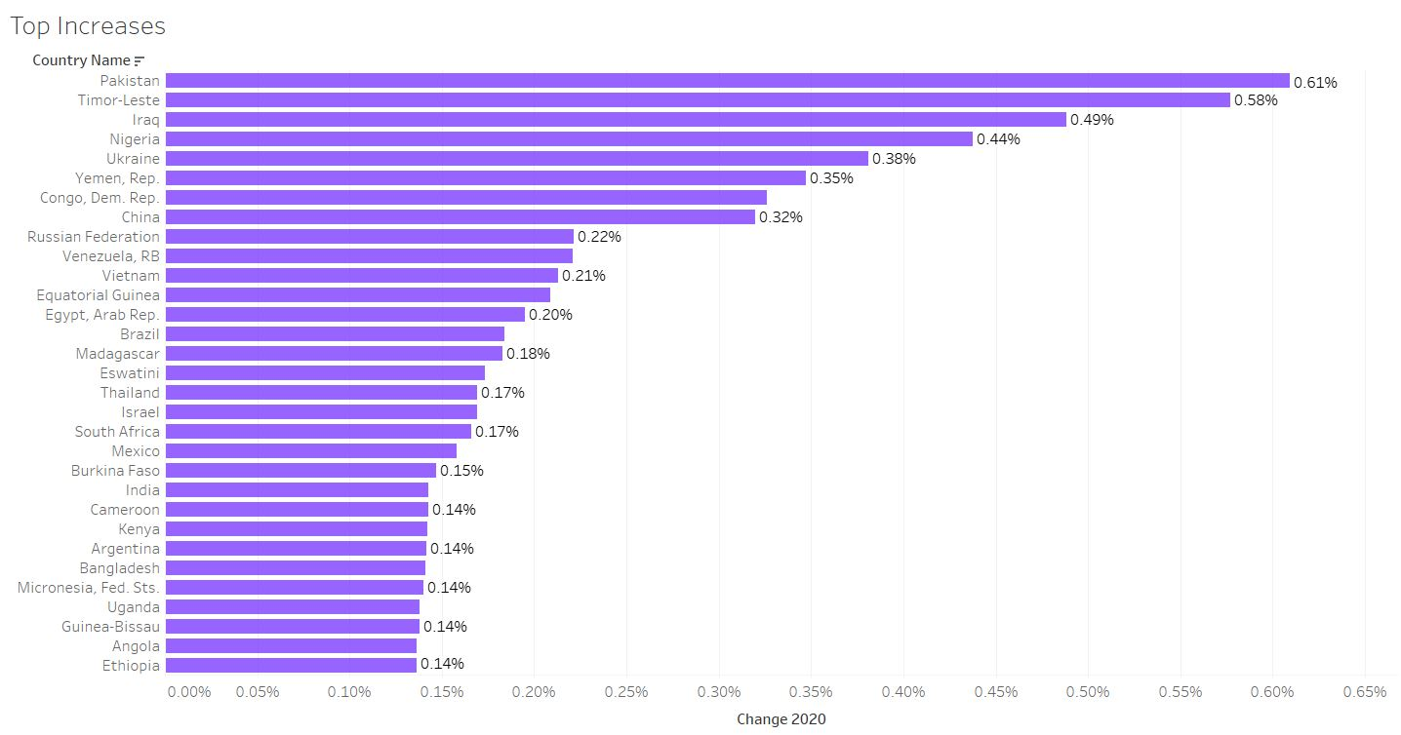
5. PREDICTIVE MODEL RESULTS: Visualized
------------------------------------------

Slide 13
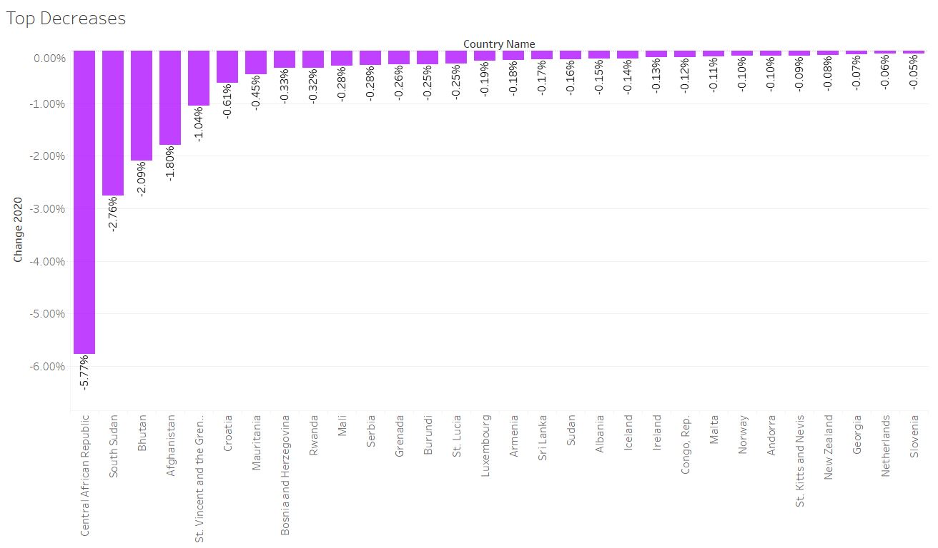
5. PREDICTIVE MODEL RESULTS: Visualized
------------------------------------------

Slide 14
6. CODING HIGHLIGHTS:
----------------------------------------------------
------------------------------------------
Melting data into one column
Creating a unique ID by merging country code and year

Slide 15
6. CODING HIGHLIGHTS:
----------------------------------------------------
------------------------------------------
Function for calculation t + varying time periods: 2, 4, 6, 8, 15 years

Slide 16
6. CODING HIGHLIGHTS:
----------------------------------------------------
------------------------------------------
Fill in missing values using means or ffill imputation methods

Slide 17
6. CHALLENGES:
------------------------------------------
Building a dataset from scratch; we were limited by the number of features we could find and missing values when joining datasets.
Difficulty in predicting such a complex global phenomenon
Our model would definitely benefit from historical data and additional features that aren’t closely correlated
We found high correlation between several of our datasets, which skews the result of our model
Model fails to capture the year-to-year variance

